Slide 1
STOR 455 Class 9
Read: 2.2
Exercises: 2.15a, 17a, 23, 29, 47

Slide 2
T-test for Slope
H_{o}: β₁ = 0
H_{a}: β₁ ≠ 0
vs.
Find p-value using a
t-distribution and n-2 d.f.
p-value is small ↔ Reject H_{o}

Slide 3
How to find a P-value?
Statistically significant evidence suggests ( p-value < 2.22*10⁻¹⁶) that there is a relationship between the hours that a student spend travelling to campus and their distance from campus.
Coefficients:
Estimate Std. Error t value Pr(>|t|)
(Intercept) -11.062617818 4.056038979 -2.72744 0.0086828 **
Hours 59.977487976 2.484167044 24.14390 < 2.22e-16 ***
---
Signif. codes: 0 ‘***’ 0.001 ‘**’ 0.01 ‘*’ 0.05 ‘.’ 0.1 ‘ ’ 1
Residual standard error: 18.26246 on 52 degrees of freedom
Multiple R-squared: 0.9181009563, Adjusted R-squared: 0.9165259747
F-statistic: 582.9280487 on 1 and 52 DF, p-value: < 2.220446e-16

Slide 4
Finding Correlation in R
For data in two variables:
cor(Domestic$Distance, Domestic$Hours)
[1] 0.9581758
For all variables in a dataframe:
data(Houses)
cor(Houses)
Price Size Lot
Price 1.0000000 0.6848219 0.7157072
Size 0.6848219 1.0000000 0.7668722
Lot 0.7157072 0.7668722 1.0000000

Slide 5
Finding Correlation in R
Watch out – variables must be numeric!
data(Cereal)
cor(Cereal)
Error in cor(Cereal) : 'x' must be numeric
May need to choose numeric columns:
cor(Cereal[c(2,3,4)])
Calories Sugar Fiber
Calories 1.0000000 0.5154008 -0.7150123
Sugar 0.5154008 1.0000000 -0.5025772
Fiber -0.7150123 -0.5025772 1.0000000

Slide 6
Test for a Linear Relationship via Correlation
Let ρ (rho) denote the population correlation
H_{o}: ρ=0
H_{a}: ρ≠0
Compare to a t-distribution with n-2 d.f.

Slide 7
Correlation t-test in R
cor.test(Domestic$Distance, Domestic$Hours)
Pearson's product-moment correlation
data: x and y
t = 24.144, df = 52, p-value < 2.2e-16
alternative hypothesis: true correlation is not equal to 0
95 percent confidence interval:
0.9286787 0.9756277
sample estimates:
cor
0.9581758
Coefficients:
Estimate Std. Error t value Pr(>|t|)
(Intercept) -11.062617818 4.056038979 -2.72744 0.0086828 **
Hours 59.977487976 2.484167044 24.14390 < 2.22e-16 ***
---
Signif. codes: 0 ‘***’ 0.001 ‘**’ 0.01 ‘*’ 0.05 ‘.’ 0.1 ‘ ’ 1
Residual standard error: 18.26246 on 52 degrees of freedom
Multiple R-squared: 0.9181009563, Adjusted R-squared: 0.9165259747
F-statistic: 582.9280487 on 1 and 52 DF, p-value: < 2.220446e-16

Slide 8
ANOVA for Regression
=
+
Data
Model
Error
=
+
TOTAL variation in response, Y
Variation explained by MODEL
Unexplained variation in RESIDUALS
Key question: Does the MODEL explain a “significant” amount of the TOTAL variability?

Slide 9
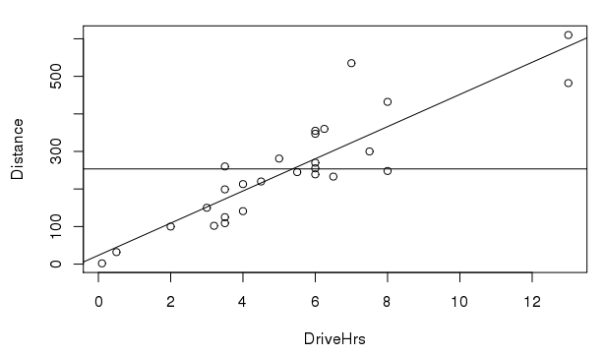

TOTAL variation in response, Y
$$\overline{y}$$
*Not our data. For visualization purposes

Slide 10

Variation explained by MODEL
$$\overline{y}$$
*Not our data. For visualization purposes

Slide 11
Unexplained variation in RESIDUALS
*Not our data. For visualization purposes

Slide 12
Partitioning Variability - SLM
Y
=
β_{o} + β₁X
+
ε
=
+
=
+
=
SSModel
+
SSE
SSTotal

Slide 13
Simple Linear Regression - R
moddist=lm(Distance~Hours, data=Domestic)
summary(moddist)
Call:
lm(formula = Distance ~ Hours, data = Domestic)
Residuals:
Min 1Q Median 3Q Max
-88.892 -4.680 2.172 7.082 26.141
Coefficients:
Estimate Std. Error t value Pr(>|t|)
(Intercept) -11.063 4.056 -2.727 0.00868 **
Hours 59.977 2.484 24.144 < 2e-16 ***
---
Signif. codes: 0 ‘***’ 0.001 ‘**’ 0.01 ‘*’ 0.05 ‘.’ 0.1 ‘ ’ 1
Residual standard error: 18.26 on 52 degrees of freedom
Multiple R-squared: 0.9181, Adjusted R-squared: 0.9165
F-statistic: 582.9 on 1 and 52 DF, p-value: < 2.2e-16

Slide 14
R – ANOVA for a Regression Model
anova(moddist)
Analysis of Variance Table
Response: Distance
Df Sum Sq Mean Sq F value Pr(>F)
Hours 1 194417 194417 582.93 < 2.2e-16 ***
Residuals 52 17343 334
---
Signif. codes: 0 ‘***’ 0.001 ‘**’ 0.01 ‘*’ 0.05 ‘.’ 0.1 ‘ ’ 1

Slide 15

ANOVA Test for Regression
Basic idea: Find two estimators of σ_{ε}²
Model ⇒
Compare
Error ⇒
Compare to F-distribution with 1 and $n−2$ d.f.

Slide 16
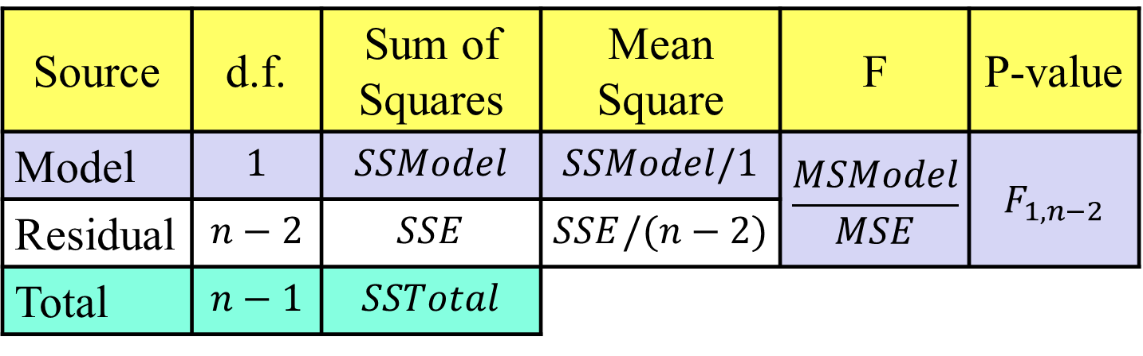


ANOVA Test for Regression
H_{o}: β₁ = 0
H_{a}: β₁ ≠ 0
vs.
($\overline{y}$)
($\hat{y}$)
Source | d.f. | Sum of Squares | Mean Square | F | P-value
Model | $$1$$ | $$SSModel$$ | $$SSModel/1$$ | $$\frac{MSModel}{MSE}$$ | $$F_{1,n−2}$$
Residual | $$n−2$$ | $$SSE$$ | $$SSE/(n−2)$$
Total | $$n−1$$ | $$SSTotal$$
in R use 1-pf(Fstat,1,n-2)

Slide 17
R – ANOVA for a Regression Model
> anova(moddist)
Analysis of Variance Table
Response: Distance
Df Sum Sq Mean Sq F value Pr(>F)
Hours 1 194417 194417 582.93 < 2.2e-16 ***
Residuals 52 17343 334
---
Signif. codes: 0 ‘***’ 0.001 ‘**’ 0.01 ‘*’ 0.05 ‘.’ 0.1 ‘ ’ 1
> summary(moddist)
Some output omitted…
Coefficients:
Estimate Std. Error t value Pr(>|t|)
(Intercept) -11.063 4.056 -2.727 0.00868 **
Hours 59.977 2.484 24.144 < 2e-16 ***
---

Slide 18
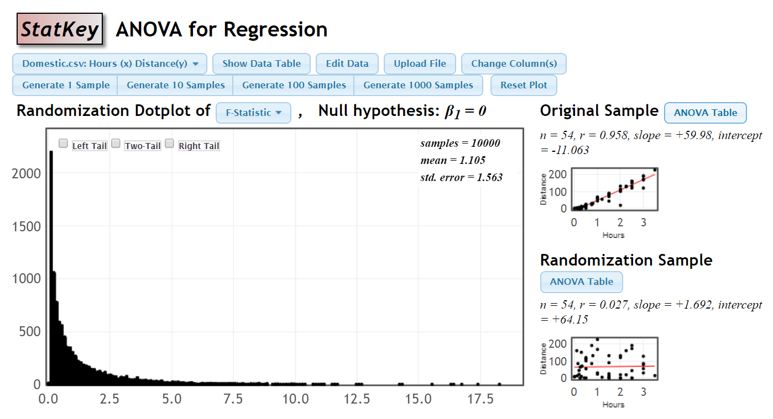
ANOVA Randomization Distribution

Slide 19
What is r²?
r² = proportion of total variability in the response (Y) that is “explained” by the model.
Residual standard error: 18.26 on 52 degrees of freedom
Multiple R-squared: 0.9181, Adjusted R-squared: 0.9165
F-statistic: 582.9 on 1 and 52 DF, p-value: < 2.2e-16
> anova(moddist)
Response: Distance
Df Sum Sq Mean Sq F value Pr(>F)
Hours 1 194417 194417 582.93 < 2.2e-16 ***
Residuals 52 17343 334

Slide 20
Visualizing r² for a SLM
Basic Idea: How much “better” does the least squares line do than a “prediction” that doesn’t use X at all?
Using NO predictor:
Least Squares Line:

Slide 21
SSTotal=211759
$$\overline{y}$$
*Not our data. For visualization purposes

Slide 22
SSE=17342
*Not our data. For visualization purposes

Slide 23
Why is it called r²?
Def: The correlation, r, measures the strength of linear association between two quantitative variables.
-1< r <1
⇒ 0 < r² < 1
Explains no variability
Explains all variability

Slide 24
T-test for slope:
Which is best?
H_{o}: β₁=0
H_{a}: β₁≠0
Compare to t _{n-2}
All three are equivalent!
ANOVA for regression:
H_{o}: β₁=0
H_{a}: β₁≠0
Compare to F_{1,n-2}
T-test for correlation:
(t_{n-2})² = F_{1,n-2}
H_{o}: ρ =0
H_{a}: ρ ≠0
Compare to t _{n-2}

Slide 25
Three Regression Tests in R
Why 3 different tests?
Multiple regression
> summary(moddist)
Coefficients:
Estimate Std. Error t value Pr(>|t|)
(Intercept) -11.063 4.056 -2.727 0.00868 **
Hours 59.977 2.484 24.144 < 2e-16 ***
anova(moddist)
Df Sum Sq Mean Sq F value Pr(>F)
Hours 1 194417 194417 582.93 < 2.2e-16 ***
Residuals 52 17343 334
> cor.test(Domestic$Distance, Domestic$Hours)
t = 24.144, df = 52, p-value < 2.2e-16

